Slide 1
SOKOINTEL / RESEARCH EXPLAINED
Ownership, Tax and Cross-Border Implementation
An educational US-market portfolio, funded and maintained through an explicit policy rather than a prediction of the next winning fund.
USMPC-03 • Dated source record • fictional calculations are labelled as illustrations
Notes:
EPISODE USMPC-03: Ownership, Tax and Cross-Border Implementation
ARTICLE: https://sokointel.com/read/usmpc-03/
RESEARCH SNAPSHOT: 10 September 2026
OPENING NARRATION
An educational US-market portfolio, funded and maintained through an explicit policy rather than a prediction of the next winning fund.
Dated source record • fictional calculations are labelled as illustrations
Introduce the decision before defining the technical terms.
ARTICLE SECTION: # Part 3: Ownership, Tax and Cross-Border Implementation
US Markets and Portfolio Construction, unified nine-part series. Research edition: 15 September 2026.
At the beginning of this research, a practical question appeared repeatedly: if two people buy exposure to the same American companies, why can their after-tax outcome, administrative burden, and estate exposure differ so much? The answer is not the ticker alone. It lies in the chain from the company to the fund, the fund to the investor, the investor's residence, and the account through which the holding is owned.
This chapter gives that chain a structure. It is an educational framework, not personal tax advice. Cross-border rules depend on residence, citizenship, domicile, family circumstances, account registration and treaty eligibility. Confirm the current position with the relevant revenue authority and a qualified adviser before acting.
ARTICLE SECTION: Start with the investor's legal and economic facts
A brokerage account often displays a trading currency, a fund ticker and a current market value. None of those fields, alone, identify the investor's tax position. A sound record starts with five facts:
| Question | Why it matters | Record to keep |
| --- | --- | --- |
| Where is the investor tax resident? | Residence can determine reporting and personal tax treatment. | Residence evidence and annual tax filing position. |
| Is the investor a US person for tax purposes? | US-person rules are distinct from non-US investor rules. | Current W-9 or equivalent status evidence. |
| What is the fund's domicile and legal structure? | Domicile can affect withholding inside the fund and estate exposure. | Prospectus, factsheet and ISIN. |
| Which account legally owns the asset? | An individual, pension, company and trust can have different rules. | Account agreement and beneficial-owner record. |
| In which currencies are future expenses due? | Currency changes the household value of the result. | Cash-flow plan, reserve currency and reporting currency. |
The first distinction is between a company dividend and the cash an investor sees. An American company may pay a dividend to a fund. Withholding can occur before the fund receives it. The fund may retain the income in an accumulating share class or distribute it. A second jurisdiction may then tax the investor. Calling a fund "tax efficient" without identifying the stage being discussed is incomplete.
Presentation assembled 25 September 2026. Educational source snapshot; no recording or publication is implied.

Slide 2
THE DECISION
The questions and the language
TERMS & UNITS
Position — market value used in the example; USD
Yield — annual gross dividend ÷ position value
Withholding — tax deducted from the distribution; %
Domicile — legal jurisdiction of the fund
Treaty eligibility — investor-specific entitlement requiring evidence
SOKOINTEL / USMPC-03
Source material and recording notes included
02
Notes:
EPISODE USMPC-03: Ownership, Tax and Cross-Border Implementation
ARTICLE: https://sokointel.com/read/usmpc-03/
RESEARCH SNAPSHOT: 10 September 2026
Read the questions naturally and define terms in context.
Position — market value used in the example; USD
Yield — annual gross dividend ÷ position value
Withholding — tax deducted from the distribution; %
Domicile — legal jurisdiction of the fund
Treaty eligibility — investor-specific entitlement requiring evidence
Research question mapping:
Presentation assembled 25 September 2026. Educational source snapshot; no recording or publication is implied.

Slide 3
FOLLOW THE MECHANISM
Begin with the investor’s facts
01
Record residence, citizenship, account owner and relevant treaty position.
02
Separate the legal domicile from the exchange and dealing currency.
03
Trace the dividend from company through fund to investor.
Dated source record • fictional calculations are labelled as illustrations
SOKOINTEL / USMPC-03
Source material and recording notes included
03
Notes:
EPISODE USMPC-03: Ownership, Tax and Cross-Border Implementation
ARTICLE: https://sokointel.com/read/usmpc-03/
RESEARCH SNAPSHOT: 10 September 2026
Explain the mechanism with the cited article section, then relate it to the opening decision.
Narration: explain each step and its consequence for the opening decision.
ARTICLE SECTION: Start with the investor's legal and economic facts
A brokerage account often displays a trading currency, a fund ticker and a current market value. None of those fields, alone, identify the investor's tax position. A sound record starts with five facts:
| Question | Why it matters | Record to keep |
| --- | --- | --- |
| Where is the investor tax resident? | Residence can determine reporting and personal tax treatment. | Residence evidence and annual tax filing position. |
| Is the investor a US person for tax purposes? | US-person rules are distinct from non-US investor rules. | Current W-9 or equivalent status evidence. |
| What is the fund's domicile and legal structure? | Domicile can affect withholding inside the fund and estate exposure. | Prospectus, factsheet and ISIN. |
| Which account legally owns the asset? | An individual, pension, company and trust can have different rules. | Account agreement and beneficial-owner record. |
| In which currencies are future expenses due? | Currency changes the household value of the result. | Cash-flow plan, reserve currency and reporting currency. |
The first distinction is between a company dividend and the cash an investor sees. An American company may pay a dividend to a fund. Withholding can occur before the fund receives it. The fund may retain the income in an accumulating share class or distribute it. A second jurisdiction may then tax the investor. Calling a fund "tax efficient" without identifying the stage being discussed is incomplete.
ARTICLE SECTION: The fund domicile is not the exchange listing
The same economic exposure can appear under more than one ticker. A fund may be domiciled in Ireland, listed in London, trade in dollars or sterling, and hold American securities. The exchange and trading currency help determine execution and conversion mechanics. The domicile identifies the fund's legal home. The ISIN is therefore more useful than a short ticker when comparing apparently similar listings.For a non-US investor, an Irish UCITS fund and a US-domiciled ETF can both offer broad American equity exposure, yet they sit in different legal and withholding chains. That does not make either route universally preferable. The comparison must include the investor's residence, platform access, dealing costs, reporting needs, dividend policy and the intended account size.
Presentation assembled 25 September 2026. Educational source snapshot; no recording or publication is implied.

Slide 4
FOLLOW THE MECHANISM
Separate withholding from estate exposure
01
A payment-tax assumption does not resolve an ownership-at-death question.
02
Retain account, security and beneficiary records.
03
Use dated rules and investor-specific eligibility before implementing a route.
Dated source record • fictional calculations are labelled as illustrations
SOKOINTEL / USMPC-03
Source material and recording notes included
04
Notes:
EPISODE USMPC-03: Ownership, Tax and Cross-Border Implementation
ARTICLE: https://sokointel.com/read/usmpc-03/
RESEARCH SNAPSHOT: 10 September 2026
Explain the mechanism with the cited article section, then relate it to the opening decision.
Narration: explain each step and its consequence for the opening decision.
ARTICLE SECTION: Estate exposure is a separate question
Income-tax withholding and estate exposure are not the same issue. The US Internal Revenue Service describes a filing threshold for certain nonresident, non-citizen estates with US-situs assets above $60,000. A direct holding of US-domiciled securities can therefore raise a question that a fund's historical return table does not answer. The relevant legal analysis depends on ownership, situs rules, any treaty position and the investor's wider estate plan. Do not treat a social-media threshold as a complete estate plan.A practical inventory helps an investor identify when specialist advice is needed:
| Holding or fact | Review question |
| --- | --- |
| US-domiciled ETF or individual US shares | Is this US-situs property for the investor's estate position? |
| Non-US fund holding US shares | How does the fund's legal structure change the analysis? |
| Joint account, trust or company | Who is the beneficial owner and how is the interest documented? |
| US citizen, green-card holder or US-resident family member | Are US-person rules relevant despite another residence? |
| A growing portfolio nearing a material threshold | Is estate planning being reviewed before an urgent event? |
The $60,000 figure is a filing and review trigger, not a universal exemption from every estate-planning consequence. A nonresident, non-citizen estate can use a $13,000 unified credit against tentative tax under the graduated U.S. estate-tax schedule. The filing question, the computation of tentative tax and the investor's treaty position are separate checks. Appendix 1 and the companion workbook show the illustrative schedule, credit and a Form 706-NA review flag. They do not replace legal or tax advice.
ARTICLE SECTION: Start with the investor's legal and economic facts
A brokerage account often displays a trading currency, a fund ticker and a current market value. None of those fields, alone, identify the investor's tax position. A sound record starts with five facts:
| Question | Why it matters | Record to keep |
| --- | --- | --- |
| Where is the investor tax resident? | Residence can determine reporting and personal tax treatment. | Residence evidence and annual tax filing position. |
| Is the investor a US person for tax purposes? | US-person rules are distinct from non-US investor rules. | Current W-9 or equivalent status evidence. |
| What is the fund's domicile and legal structure? | Domicile can affect withholding inside the fund and estate exposure. | Prospectus, factsheet and ISIN. |
| Which account legally owns the asset? | An individual, pension, company and trust can have different rules. | Account agreement and beneficial-owner record. |
| In which currencies are future expenses due? | Currency changes the household value of the result. | Cash-flow plan, reserve currency and reporting currency. |
The first distinction is between a company dividend and the cash an investor sees. An American company may pay a dividend to a fund. Withholding can occur before the fund receives it. The fund may retain the income in an accumulating share class or distribute it. A second jurisdiction may then tax the investor. Calling a fund "tax efficient" without identifying the stage being discussed is incomplete.
Presentation assembled 25 September 2026. Educational source snapshot; no recording or publication is implied.

Slide 5
FOLLOW THE MECHANISM
Currency belongs in the same record
01
Fund denomination and trading currency do not define every underlying exposure.
02
Match near-term cash obligations to their spending currency.
03
Compare custody, funding, reporting and exit costs as one implementation path.
Dated source record • fictional calculations are labelled as illustrations
SOKOINTEL / USMPC-03
Source material and recording notes included
05
Notes:
EPISODE USMPC-03: Ownership, Tax and Cross-Border Implementation
ARTICLE: https://sokointel.com/read/usmpc-03/
RESEARCH SNAPSHOT: 10 September 2026
Explain the mechanism with the cited article section, then relate it to the opening decision.
Narration: explain each step and its consequence for the opening decision.
ARTICLE SECTION: Currency belongs beside tax and custody
Buying a sterling or shilling trading line does not itself change the currency exposure of the underlying companies. The listing currency affects how an investor transacts. The economic result depends on the asset return, exchange rates between the asset and spending currencies, and any explicit hedge.
\[ R_{\text{home}} = (1 + R_{\text{asset}})\left(\frac{S_1}{S_0}\right) - 1 \]
For an investor reporting in shillings, \(S\) can be KES per dollar. A dollar asset return can be offset or amplified by the change in that exchange rate. This is not an instruction to forecast currencies. It is a reason to separate a near-term reserve for known spending from a long-horizon investment allocation.
ARTICLE SECTION: A repeatable implementation record
Before funding an overseas account, record the same facts each time: intended exposure, fund ISIN and domicile, dealing venue, quoted spread, commission, conversion method, personal tax status, the source and date of each rule, and the reason the holding belongs in the policy. Retain trade confirmations, statements and tax forms. A spreadsheet can total costs, but it cannot repair a missing legal fact.!A cross-border investment workflow from investor facts through funding, custody, tax records and review.
The next chapter moves from ownership constraints to portfolio architecture. The purpose is not to find a universal list of funds. It is to decide what role each holding has, what loss it can create, and which additional idea would genuinely improve the existing policy.
Presentation assembled 25 September 2026. Educational source snapshot; no recording or publication is implied.

Slide 6
THE RELATIONSHIP
Trace the withholding cash flow
Net dividend = position × dividend yield × (1 − withholding rate)
USD 10,000 × 1.3% × (1 − 30%) = USD 91.00.
At an illustrative eligible 15% rate, net cash is USD 110.50: a USD 19.50 difference before other costs.
Dated source record • fictional calculations are labelled as illustrations
SOKOINTEL / USMPC-03
Source material and recording notes included
06
Notes:
EPISODE USMPC-03: Ownership, Tax and Cross-Border Implementation
ARTICLE: https://sokointel.com/read/usmpc-03/
RESEARCH SNAPSHOT: 10 September 2026
Article worked example and saved workbook evidence; preserve their separate assumptions.
Equation: Net dividend = position × dividend yield × (1 − withholding rate)
Substitution: USD 10,000 × 1.3% × (1 − 30%) = USD 91.00.
Interpretation: At an illustrative eligible 15% rate, net cash is USD 110.50: a USD 19.50 difference before other costs.
ARTICLE SECTION: Make withholding a flow, not a slogan
Consider an illustrative $100,000 investment in comparable US equity exposure with a 1.5% gross dividend yield. Assume, solely to show the arithmetic, that one route suffers 30% withholding at the dividend stage and another suffers 15%, while annual fund charges are 0.03% and 0.07% respectively.
| Item | Route A: 30% withholding, 0.03% fee | Route B: 15% withholding, 0.07% fee |
| --- | ---: | ---: |
| Gross dividend | $1,500 | $1,500 |
| Illustrative withholding | $450 | $225 |
| Annual fund charge on starting value | $30 | $70 |
| Simplified annual structural drag | $480 | $295 |
\[\text{Approximate drag} = V\left(y \times w + f\right)\]
Here, \(V\) is portfolio value, \(y\) is gross dividend yield, \(w\) is the withholding rate and \(f\) is the annual fund charge. The comparison excludes personal tax, trading, foreign-exchange cost, tracking difference and the timing of distributions. It does not forecast realised fund returns.The most useful feature of the calculation is its break-even logic. If Route B costs four basis points more each year but reduces the illustrative withholding rate by fifteen percentage points, the gross dividend yield at which that difference offsets the extra fee is:
\[y_{\text{break-even}} = \frac{0.0007 - 0.0003}{0.30 - 0.15} \approx 0.2667\%\]
A result is only as useful as its inputs. A different treaty entitlement, dividend yield, account size or dealing cost can change it. The disciplined action is to keep the assumptions visible and update them when the investor's position changes.
ARTICLE SECTION: Start with the investor's legal and economic facts
A brokerage account often displays a trading currency, a fund ticker and a current market value. None of those fields, alone, identify the investor's tax position. A sound record starts with five facts:
| Question | Why it matters | Record to keep |
| --- | --- | --- |
| Where is the investor tax resident? | Residence can determine reporting and personal tax treatment. | Residence evidence and annual tax filing position. |
| Is the investor a US person for tax purposes? | US-person rules are distinct from non-US investor rules. | Current W-9 or equivalent status evidence. |
| What is the fund's domicile and legal structure? | Domicile can affect withholding inside the fund and estate exposure. | Prospectus, factsheet and ISIN. |
| Which account legally owns the asset? | An individual, pension, company and trust can have different rules. | Account agreement and beneficial-owner record. |
| In which currencies are future expenses due? | Currency changes the household value of the result. | Cash-flow plan, reserve currency and reporting currency. |
The first distinction is between a company dividend and the cash an investor sees. An American company may pay a dividend to a fund. Withholding can occur before the fund receives it. The fund may retain the income in an accumulating share class or distribute it. A second jurisdiction may then tax the investor. Calling a fund "tax efficient" without identifying the stage being discussed is incomplete.
Presentation assembled 25 September 2026. Educational source snapshot; no recording or publication is implied.

Slide 7
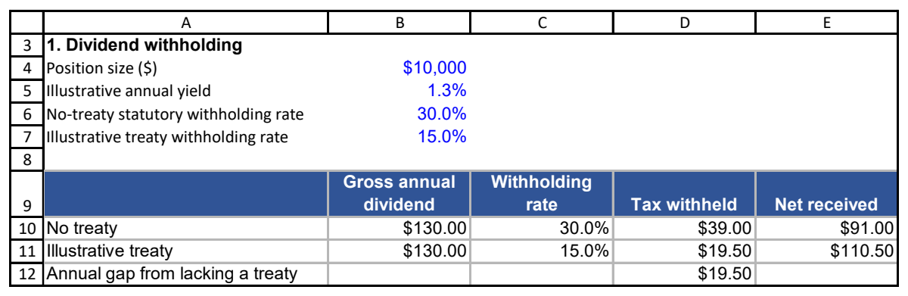
WORKBOOK EVIDENCE
P03 Cross-Border Tax: follow the saved workbook
P03 Cross-Border Tax!A3:E12
Dated source record • fictional calculations are labelled as illustrations
SOKOINTEL / USMPC-03
Source material and recording notes included
07
Notes:
EPISODE USMPC-03: Ownership, Tax and Cross-Border Implementation
ARTICLE: https://sokointel.com/read/usmpc-03/
RESEARCH SNAPSHOT: 10 September 2026
ACTUAL WORKBOOK CAPTURE
Workbook: C:\Users\Nevo\Downloads\financial material\US Markets and Portfolio Construction\US_Markets_Portfolio_Construction_Final_Workbook.xlsx
Sheet/range: 'P03 Cross-Border Tax'!A3:E12
SHA-256: 5a040bdadf9c5682f5370a882c44aec18bb6359ea96bcd8121b634d35620ab38
Capture method: Microsoft Excel read-only PDF range export. Print headings retained. Source not saved.
Asset: Evidence/Workbooks/USMPC-03-01-p1.png
SCREEN RECORDING WALKTHROUGH
Read the row and column headings. Identify inputs, follow the dependent row and explain the units. Do not alter the source workbook while recording; use a copy for a new scenario.
Extracted evidence text:
3
4
5
6
7
8
9
10
11
12
A B C D E
1. Dividend withholding
Position size ($) $10,000
Illustrative annual yield 1.3%
No-treaty statutory withholding rate 30.0%
Illustrative treaty withholding rate 15.0%
Gross annual
dividend
Withholding
rate Tax withheld Net received
No treaty $130.00 30.0% $39.00 $91.00
Illustrative treaty $130.00 15.0% $19.50 $110.50
Annual gap from lacking a treaty $19.50
Relevant article context:
ARTICLE SECTION: # Part 3: Ownership, Tax and Cross-Border Implementation
US Markets and Portfolio Construction, unified nine-part series. Research edition: 15 September 2026.
At the beginning of this research, a practical question appeared repeatedly: if two people buy exposure to the same American companies, why can their after-tax outcome, administrative burden, and estate exposure differ so much? The answer is not the ticker alone. It lies in the chain from the company to the fund, the fund to the investor, the investor's residence, and the account through which the holding is owned.
This chapter gives that chain a structure. It is an educational framework, not personal tax advice. Cross-border rules depend on residence, citizenship, domicile, family circumstances, account registration and treaty eligibility. Confirm the current position with the relevant revenue authority and a qualified adviser before acting.
ARTICLE SECTION: A repeatable implementation record
Before funding an overseas account, record the same facts each time: intended exposure, fund ISIN and domicile, dealing venue, quoted spread, commission, conversion method, personal tax status, the source and date of each rule, and the reason the holding belongs in the policy. Retain trade confirmations, statements and tax forms. A spreadsheet can total costs, but it cannot repair a missing legal fact.!A cross-border investment workflow from investor facts through funding, custody, tax records and review.
The next chapter moves from ownership constraints to portfolio architecture. The purpose is not to find a universal list of funds. It is to decide what role each holding has, what loss it can create, and which additional idea would genuinely improve the existing policy.
Presentation assembled 25 September 2026. Educational source snapshot; no recording or publication is implied.

Slide 8
CHANGE THE ASSUMPTION
Treaty eligibility changes the payment assumption
BASE / STARTING RECORD
CHANGED CASE / NEW EVIDENCE
No-treaty illustration: 30% withholding on USD 130.
Eligible illustrative treaty treatment: 15% on the same USD 130.
Tax withheld falls from USD 39 to USD 19.50. Actual eligibility must be documented.
Sensitivity or evidence comparison; interpretation depends on the stated assumptions.
SOKOINTEL / USMPC-03
Source material and recording notes included
08
Notes:
EPISODE USMPC-03: Ownership, Tax and Cross-Border Implementation
ARTICLE: https://sokointel.com/read/usmpc-03/
RESEARCH SNAPSHOT: 10 September 2026
Teaching sensitivity; hold other assumptions fixed unless a multi-input case is explicitly named.
Base: No-treaty illustration: 30% withholding on USD 130.
Changed: Eligible illustrative treaty treatment: 15% on the same USD 130.
Consequence: Tax withheld falls from USD 39 to USD 19.50. Actual eligibility must be documented.
ARTICLE SECTION: Make withholding a flow, not a slogan
Consider an illustrative $100,000 investment in comparable US equity exposure with a 1.5% gross dividend yield. Assume, solely to show the arithmetic, that one route suffers 30% withholding at the dividend stage and another suffers 15%, while annual fund charges are 0.03% and 0.07% respectively.
| Item | Route A: 30% withholding, 0.03% fee | Route B: 15% withholding, 0.07% fee |
| --- | ---: | ---: |
| Gross dividend | $1,500 | $1,500 |
| Illustrative withholding | $450 | $225 |
| Annual fund charge on starting value | $30 | $70 |
| Simplified annual structural drag | $480 | $295 |
\[\text{Approximate drag} = V\left(y \times w + f\right)\]
Here, \(V\) is portfolio value, \(y\) is gross dividend yield, \(w\) is the withholding rate and \(f\) is the annual fund charge. The comparison excludes personal tax, trading, foreign-exchange cost, tracking difference and the timing of distributions. It does not forecast realised fund returns.The most useful feature of the calculation is its break-even logic. If Route B costs four basis points more each year but reduces the illustrative withholding rate by fifteen percentage points, the gross dividend yield at which that difference offsets the extra fee is:
\[y_{\text{break-even}} = \frac{0.0007 - 0.0003}{0.30 - 0.15} \approx 0.2667\%\]
A result is only as useful as its inputs. A different treaty entitlement, dividend yield, account size or dealing cost can change it. The disciplined action is to keep the assumptions visible and update them when the investor's position changes.
ARTICLE SECTION: # Part 3: Ownership, Tax and Cross-Border Implementation
US Markets and Portfolio Construction, unified nine-part series. Research edition: 15 September 2026.
At the beginning of this research, a practical question appeared repeatedly: if two people buy exposure to the same American companies, why can their after-tax outcome, administrative burden, and estate exposure differ so much? The answer is not the ticker alone. It lies in the chain from the company to the fund, the fund to the investor, the investor's residence, and the account through which the holding is owned.
This chapter gives that chain a structure. It is an educational framework, not personal tax advice. Cross-border rules depend on residence, citizenship, domicile, family circumstances, account registration and treaty eligibility. Confirm the current position with the relevant revenue authority and a qualified adviser before acting.
Presentation assembled 25 September 2026. Educational source snapshot; no recording or publication is implied.

Slide 9
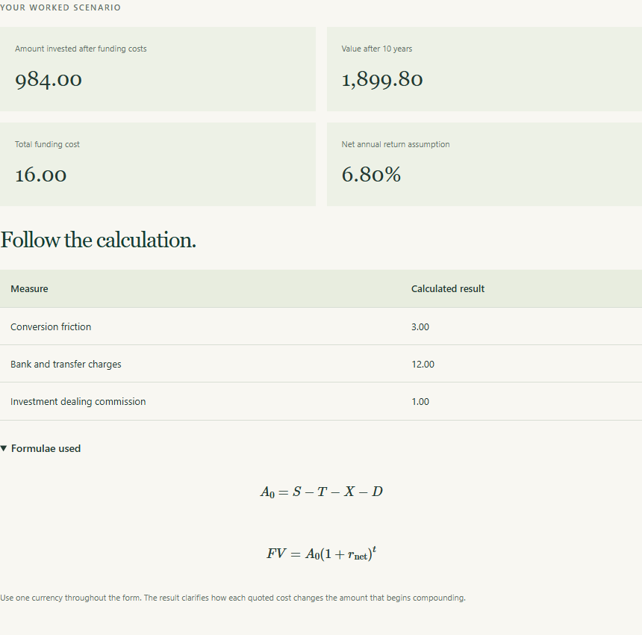
SAVED WEB DEMONSTRATION
A focused calculator demonstration
WHAT THIS TOOL DOES
Compare funding and FX charges for the same amount and route. Check the customer, account ownership and currency assumptions.
Fund domicile, residence and tax treatment require the separate article record.
Saved production page • /calculators/global-funding/ • captured 2026-09-25
SOKOINTEL / USMPC-03
Source material and recording notes included
09
Notes:
EPISODE USMPC-03: Ownership, Tax and Cross-Border Implementation
ARTICLE: https://sokointel.com/read/usmpc-03/
RESEARCH SNAPSHOT: 10 September 2026
REAL WEB CAPTURE
{
"slug": "global-funding",
"url": "https://sokointel.com/calculators/global-funding/",
"captured_at": "2026-09-25T05:01:35.774Z",
"inputs": [
{
"name": "starting_amount",
"value": "1000"
},
{
"name": "transfer_fee",
"value": "12"
},
{
"name": "fx_friction",
"value": "0.3"
},
{
"name": "dealing_commission",
"value": "1"
},
{
"name": "annual_return",
"value": "7"
},
{
"name": "annual_fund_charge",
"value": "0.2"
},
{
"name": "years",
"value": "10"
}
],
"screenshots": [
"global-funding-inputs.png",
"global-funding-full.png",
"global-funding-results.png",
"global-funding-summary.png"
],
"get_status": 200,
"title": "Global funding planner | Sokointel",
"post_status": 200,
"results_text": "YOUR WORKED SCENARIO\n\nAmount invested after funding costs\n984.00\nValue after 10 years\n1,899.80\nTotal funding cost\n16.00\nNet annual return assumption\n6.80%\nFollow the calculation.\nMeasure\tCalculated result\nConversion friction\t3.00\nBank and transfer charges\t12.00\nInvestment dealing commission\t1.00\nFormulae used\n𝐴\n0\n=\n𝑆\n−\n𝑇\n−\n𝑋\n−\n𝐷\n𝐹\n𝑉\n=\n𝐴\n0\n(\n1\n+\n𝑟\nnet\n)\n𝑡\n\nUse one currency throughout the form. The result clarifies how each quoted cost changes the amount that begins compounding.\n\nTake the research further.\n\nUse the full article and companion resources to put this calculation into its wider business, household, or portfolio context. The workbook keeps the deeper scenario modelling, data record and audit trail.\n\nRead the global-funding research →",
"alerts": [],
"base": "Evidence/Web"
}
DEMONSTRATION SCOPE
Compare funding and FX charges for the same amount and route. Check the customer, account ownership and currency assumptions.
Fund domicile, residence and tax treatment require the separate article record.
The calculator defaults may be a separate teaching example. Do not claim the displayed default equals the article or workbook case unless inputs and conventions have been reconciled. DCF uses FCFF discounted at WACC, subtracting net debt once; do not put after-interest owner earnings into that model. For financial companies use the separate capital model.
For the DCA dividend capture only: the original page renders a fraction as a percentage without multiplying by 100. The derived screenshot is an exact table crop excluding that card, not a retouched page. Correct yield = 1,015.5093/100,000 ×100 = 1.0155093%, approximately 1.02%. The protected tool was not changed.
The DCA portfolio calculator is limited to purchase/allocation mechanics and does not calculate a 30-company HHI, correlation or a stress loss. The compounding explorer is a constant-return contribution-timing model, not a sequence-of-returns withdrawal simulation.
Presentation assembled 25 September 2026. Educational source snapshot; no recording or publication is implied.

Slide 10
ANSWER THE OPENING QUESTION
What the evidence lets us conclude
The same underlying exposure can produce different outcomes through residence, domicile, withholding, custody and currency. Preserve the investor’s dated facts and document the entire route.
YOUR NEXT RECORD
Complete an investor-to-fund implementation record with documented eligibility and source dates.
SOKOINTEL / USMPC-03
Source material and recording notes included
10
Notes:
EPISODE USMPC-03: Ownership, Tax and Cross-Border Implementation
ARTICLE: https://sokointel.com/read/usmpc-03/
RESEARCH SNAPSHOT: 10 September 2026
Answer: The same underlying exposure can produce different outcomes through residence, domicile, withholding, custody and currency. Preserve the investor’s dated facts and document the entire route.
Viewer task: Complete an investor-to-fund implementation record with documented eligibility and source dates.
Return to each opening research question and identify what remains conditional or unknown.
ARTICLE SECTION: A repeatable implementation record
Before funding an overseas account, record the same facts each time: intended exposure, fund ISIN and domicile, dealing venue, quoted spread, commission, conversion method, personal tax status, the source and date of each rule, and the reason the holding belongs in the policy. Retain trade confirmations, statements and tax forms. A spreadsheet can total costs, but it cannot repair a missing legal fact.!A cross-border investment workflow from investor facts through funding, custody, tax records and review.
The next chapter moves from ownership constraints to portfolio architecture. The purpose is not to find a universal list of funds. It is to decide what role each holding has, what loss it can create, and which additional idea would genuinely improve the existing policy.
ARTICLE SECTION: # Part 3: Ownership, Tax and Cross-Border Implementation
US Markets and Portfolio Construction, unified nine-part series. Research edition: 15 September 2026.
At the beginning of this research, a practical question appeared repeatedly: if two people buy exposure to the same American companies, why can their after-tax outcome, administrative burden, and estate exposure differ so much? The answer is not the ticker alone. It lies in the chain from the company to the fund, the fund to the investor, the investor's residence, and the account through which the holding is owned.
This chapter gives that chain a structure. It is an educational framework, not personal tax advice. Cross-border rules depend on residence, citizenship, domicile, family circumstances, account registration and treaty eligibility. Confirm the current position with the relevant revenue authority and a qualified adviser before acting.
Presentation assembled 25 September 2026. Educational source snapshot; no recording or publication is implied.

Slide 11
SOURCE RECORD
Sources, dates and companion material
Read the episode: sokointel.com/read/usmpc-03/
1. Source article: Ownership, Tax and Cross-Border Implementation
2. Companion workbook: US_Markets_Portfolio_Construction_Final_Workbook
3. Exact source ranges: 'P03 Cross-Border Tax'!A3:E12
4. Source dates and assumptions: retain the period labels in the article and captured workbook; full provenance in notes.
Full source references, workbook paths, cell ranges and capture metadata are preserved in speaker notes and the episode manifest.
SOKOINTEL / USMPC-03
Source material and recording notes included
11
Notes:
EPISODE USMPC-03: Ownership, Tax and Cross-Border Implementation
ARTICLE: https://sokointel.com/read/usmpc-03/
RESEARCH SNAPSHOT: 10 September 2026
SOURCE MATERIAL
All linked source URLs:
Additional content sources:
[]
Workbook provenance:
C:\Users\Nevo\Downloads\financial material\US Markets and Portfolio Construction\US_Markets_Portfolio_Construction_Final_Workbook.xlsx
'P03 Cross-Border Tax'!A3:E12
5a040bdadf9c5682f5370a882c44aec18bb6359ea96bcd8121b634d35620ab38
Article catalog snapshot hash: e4605210b04811ea848b3d4bef140d9caaeb16174d1488e3d29f8d71eb6a9f45
Presentation assembled 25 September 2026. Educational source snapshot; no recording or publication is implied.

